Slide 1
Process Scheduling

Slide 2
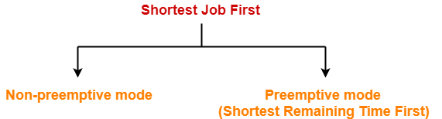
Shortest Job First
Out of all the available processes, CPU is assigned to the process having smallest burst time.
In case of a tie, it is broken by FCFS Scheduling.

Slide 3
Example-01:
Process Id | Arrival time | Burst time
P1 | 3 | 1
P2 | 1 | 4
P3 | 4 | 2
P4 | 0 | 6
P5 | 2 | 3
Consider the set of 5 processes whose arrival time and burst time are given below-
If the CPU scheduling policy is SJF non-preemptive, calculate the average waiting time and average turn around time.

Slide 4
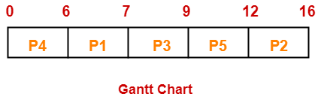

Slide 5
Process Id | Exit time | Turn Around time | Waiting time
P1 | 7 | 7 – 3 = 4 | 4 – 1 = 3
P2 | 16 | 16 – 1 = 15 | 15 – 4 = 11
P3 | 9 | 9 – 4 = 5 | 5 – 2 = 3
P4 | 6 | 6 – 0 = 6 | 6 – 6 = 0
P5 | 12 | 12 – 2 = 10 | 10 – 3 = 7

Slide 6
Average T.A.T & W.T
Average Turn Around time = (4 + 15 + 5 + 6 + 10) / 5 = 40 / 5 = 8 unit
Average waiting time = (3 + 11 + 3 + 0 + 7) / 5 = 24 / 5 = 4.8 unit

Slide 7
Example-02:
Process Id | Arrival time | Burst time
P1 | 3 | 1
P2 | 1 | 4
P3 | 4 | 2
P4 | 0 | 6
P5 | 2 | 3
Consider the set of 5 processes whose arrival time and burst time are given below-
If the CPU scheduling policy is SJF preemptive, calculate the average waiting time and average turn around time.

Slide 8
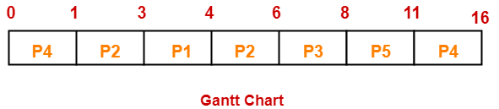

Slide 9
Process Id | Exit time | Turn Around time | Waiting time
P1 | 4 | 4 – 3 = 1 | 1 – 1 = 0
P2 | 6 | 6 – 1 = 5 | 5 – 4 = 1
P3 | 8 | 8 – 4 = 4 | 4 – 2 = 2
P4 | 16 | 16 – 0 = 16 | 16 – 6 = 10
P5 | 11 | 11 – 2 = 9 | 9 – 3 = 6

Slide 10
SRTF Performance Metrics
Average Turn Around time = (1 + 5 + 4 + 16 + 9) / 5 = 35 / 5 = 7 unit
Average waiting time = (0 + 1 + 2 + 10 + 6) / 5 = 19 / 5 = 3.8 unit

Slide 11
Class Exercise:
Consider the set of 6 processes whose arrival time and burst time
If the CPU scheduling policy is shortest remaining time first, calculate the average waiting time and average turn around time.
Process Id | Arrival time | Burst time
P1 | 0 | 7
P2 | 1 | 5
P3 | 2 | 3
P4 | 3 | 1
P5 | 4 | 2
P6 | 5 | 1

Slide 12
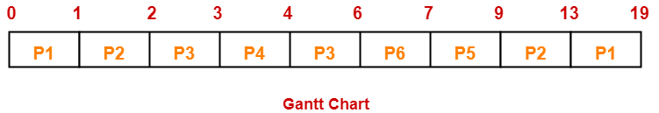
Exercise Solution

Slide 13
Exercise Solution
Process Id | Exit time | Turn Around time | Waiting time
P1 | 19 | 19 – 0 = 19 | 19 – 7 = 12
P2 | 13 | 13 – 1 = 12 | 12 – 5 = 7
P3 | 6 | 6 – 2 = 4 | 4 – 3 = 1
P4 | 4 | 4 – 3 = 1 | 1 – 1 = 0
P5 | 9 | 9 – 4 = 5 | 5 – 2 = 3
P6 | 7 | 7 – 5 = 2 | 2 – 1 = 1
Now,
Average Turn Around time = (19 + 12 + 4 + 1 + 5 + 2) / 6 = 43 / 6 = 7.17 unit
Average waiting time = (12 + 7 + 1 + 0 + 3 + 1) / 6 = 24 / 6 = 4 unit

Slide 14
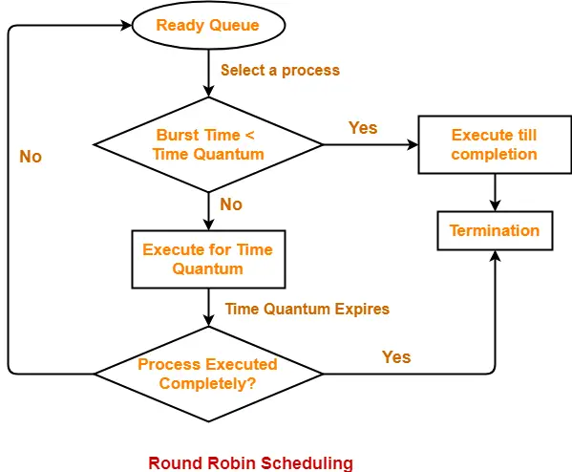

Slide 15
Example-01:
Consider the set of 5 processes whose arrival time and burst time are given below-
If the CPU scheduling policy is Round Robin with time quantum = 2 unit, calculate the average waiting time and average turn around time.
Process Id | Arrival time | Burst time
P1 | 0 | 5
P2 | 1 | 3
P3 | 2 | 1
P4 | 3 | 2
P5 | 4 | 3

Slide 16
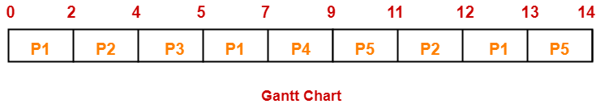
Ready Queue-
P5, P1, P2, P5, P4, P1, P3, P2, P1

Slide 17
Calculations
Now,
Average Turn Around time = (13 + 11 + 3 + 6 + 10) / 5 = 43 / 5 = 8.6 unit
Average waiting time = (8 + 8 + 2 + 4 + 7) / 5 = 29 / 5 = 5.8 unit
Process Id | Exit time | Turn Around time | Waiting time
P1 | 13 | 13 – 0 = 13 | 13 – 5 = 8
P2 | 12 | 12 – 1 = 11 | 11 – 3 = 8
P3 | 5 | 5 – 2 = 3 | 3 – 1 = 2
P4 | 9 | 9 – 3 = 6 | 6 – 2 = 4
P5 | 14 | 14 – 4 = 10 | 10 – 3 = 7

Slide 18
Example-02
Consider the set of 6 processes whose arrival time and burst time are given below-
If the CPU scheduling policy is Round Robin with time quantum = 2, calculate the average waiting time and average turn around time.
Process Id | Arrival time | Burst time
P1 | 0 | 4
P2 | 1 | 5
P3 | 2 | 2
P4 | 3 | 1
P5 | 4 | 6
P6 | 6 | 3

Slide 19
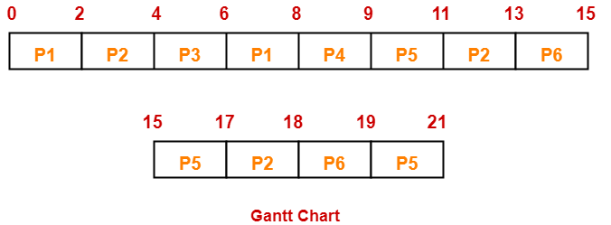
Solution
Ready Queue-
P5, P6, P2, P5, P6, P2, P5, P4, P1, P3, P2, P1

Slide 20
Solution
Now,
Average Turn Around time = (8 + 17 + 4 + 6 + 17 + 13) / 6 = 65 / 6 = 10.84 unit
Average waiting time = (4 + 12 + 2 + 5 + 11 + 10) / 6 = 44 / 6 = 7.33 unit
Process Id | Exit time | Turn Around time | Waiting time
P1 | 8 | 8 – 0 = 8 | 8 – 4 = 4
P2 | 18 | 18 – 1 = 17 | 17 – 5 = 12
P3 | 6 | 6 – 2 = 4 | 4 – 2 = 2
P4 | 9 | 9 – 3 = 6 | 6 – 1 = 5
P5 | 21 | 21 – 4 = 17 | 17 – 6 = 11
P6 | 19 | 19 – 6 = 13 | 13 – 3 = 10

Slide 21
Class Exercise
Consider the set of 6 processes whose arrival time and burst time are given below-
If the CPU scheduling policy is Round Robin with time quantum = 3, calculate the average waiting time and average turn around time.
Process Id | Arrival time | Burst time
P1 | 5 | 5
P2 | 4 | 6
P3 | 3 | 7
P4 | 1 | 9
P5 | 2 | 2
P6 | 6 | 3

Slide 22
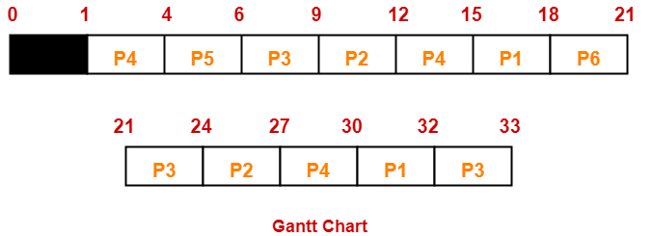
Solution
Ready Queue-
P3, P1, P4, P2, P3, P6, P1, P4, P2, P3, P5, P4

Slide 23
Solution
Now,
Average Turn Around time = (27 + 23 + 30 + 29 + 4 + 15) / 6 = 128 / 6 = 21.33 unit
Average waiting time = (22 + 17 + 23 + 20 + 2 + 12) / 6 = 96 / 6 = 16 unit
Process Id | Exit time | Turn Around time | Waiting time
P1 | 32 | 32 – 5 = 27 | 27 – 5 = 22
P2 | 27 | 27 – 4 = 23 | 23 – 6 = 17
P3 | 33 | 33 – 3 = 30 | 30 – 7 = 23
P4 | 30 | 30 – 1 = 29 | 29 – 9 = 20
P5 | 6 | 6 – 2 = 4 | 4 – 2 = 2
P6 | 21 | 21 – 6 = 15 | 15 – 3 = 12

Slide 24
Process Scheduling with I/O Time
Problem-01:
Consider three process, all arriving at time zero, with total execution time of 10, 20 and 30 units respectively. Each process spends the first 20% of execution time doing I/O, the next 70% of time doing computation, and the last 10% of time doing I/O again. The operating system uses a shortest remaining compute time first scheduling algorithm and schedules a new process either when the running process gets blocked on I/O or when the running process finishes its compute burst. Assume that all I/O operations can be overlapped as much as possible. For what percentage of does the CPU remain idle?

Slide 25
 | Total Burst Time | I/O Burst | CPU Burst | I/O Burst
P1 | 10 | 2 | 7 | 1
P2 | 20 | 4 | 14 | 2
P3 | 30 | 6 | 21 | 3

Slide 26
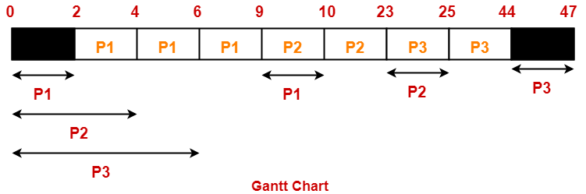

Slide 27
Percentage of time CPU remains idle
= (5 / 47) x 100
= 10.638%

Slide 28
Process No. | Arrival Time | Burst Time
 |  | CPU Burst | I/O Burst | CPU Burst
P1 | 0 | 3 | 2 | 2
P2 | 0 | 2 | 4 | 1
P3 | 2 | 1 | 3 | 2
P4 | 5 | 2 | 2 | 1
If the CPU scheduling policy is Shortest Remaining Time First, calculate the average waiting time and average turn around time.

Slide 29
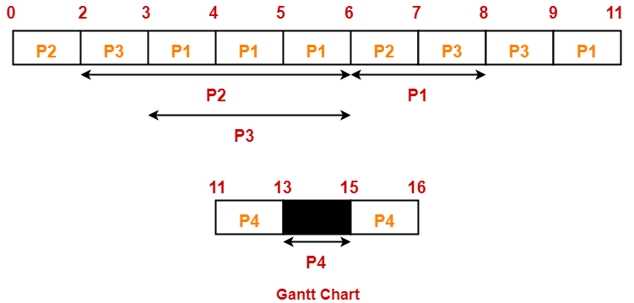

Slide 30
Process Id | Exit time | Turn Around time | Waiting time
P1 | 11 | 11 – 0 = 11 | 11 – (3+2) = 6
P2 | 7 | 7 – 0 = 7 | 7 – (2+1) = 4
P3 | 9 | 9 – 2 = 7 | 7 – (1+2) = 4
P4 | 16 | 16 – 5 = 11 | 11 – (2+1) = 8

Slide 31
Now,
Average Turn Around time = (11 + 7 + 7 + 11) / 4 = 36 / 4 = 9 units
Average waiting time = (6 + 4 + 4 + 8) / 4 = 22 / 5 = 4.4 units

Slide 32
Process No. | Arrival Time | Priority | Burst Time
 |  |  | CPU Burst | I/O Burst | CPU Burst
P1 | 0 | 2 | 1 | 5 | 3
P2 | 2 | 3 | 3 | 3 | 1
P3 | 3 | 1 | 2 | 3 | 1
Problem-03:
Consider the set of 4 processes whose arrival time and burst time are given below-
If the CPU scheduling policy is Priority Scheduling, calculate the average waiting time and average turn around time. (Lower number means higher priority)

Slide 33
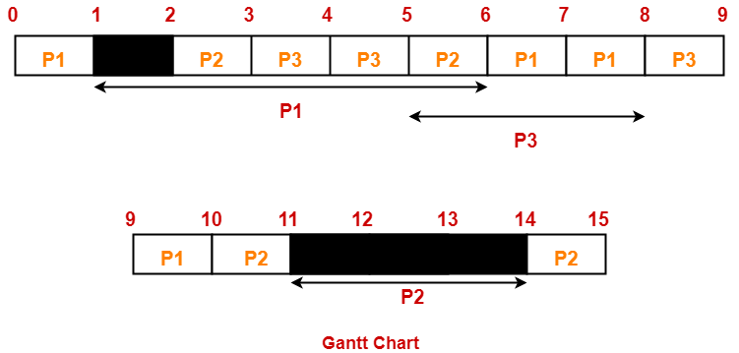

Slide 34
Calculations
Process Id | Exit time | Turn Around time | Waiting time
P1 | 10 | 10 – 0 = 10 | 10 – (1+3) = 6
P2 | 15 | 15 – 2 = 13 | 13 – (3+1) = 9
P3 | 9 | 9 – 3 = 6 | 6 – (2+1) = 3
Average Turn Around time = (10 + 13 + 6) / 3 = 29 / 3 = 9.67 units
Average waiting time = (6 + 9 + 3) / 3 = 18 / 3 = 6 units

